Slide 1
Capstone Assignment
Opening an Asian restaurant in Ottawa, Ontario

Slide 2
Business Problem
Ann, the client, just moved to Ottawa and is looking to open an Asian restaurant. Ann would like to find a location with high population density, a high ratio of asian population, and a low number of popular asian restaurants as competition. Where should Ann open her restaurant?

Slide 3
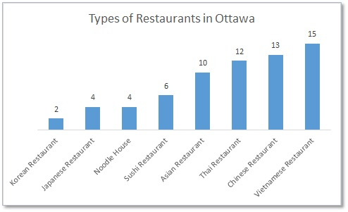
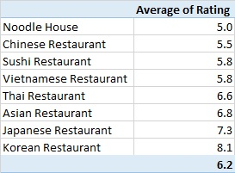
Background: Ottawa’s trending restaurants
-66 Asian restaurants ¹
-Dominated by: Thai, Chinese and Vietnamese restaurants
-6.2 average restaurant rating (ranging from Noodle houses at 5.0 to Korean restaurants at 8.1)
¹ For the scope of the capstone project, only restaurants found in the Foursquare DB will be used.

Slide 4
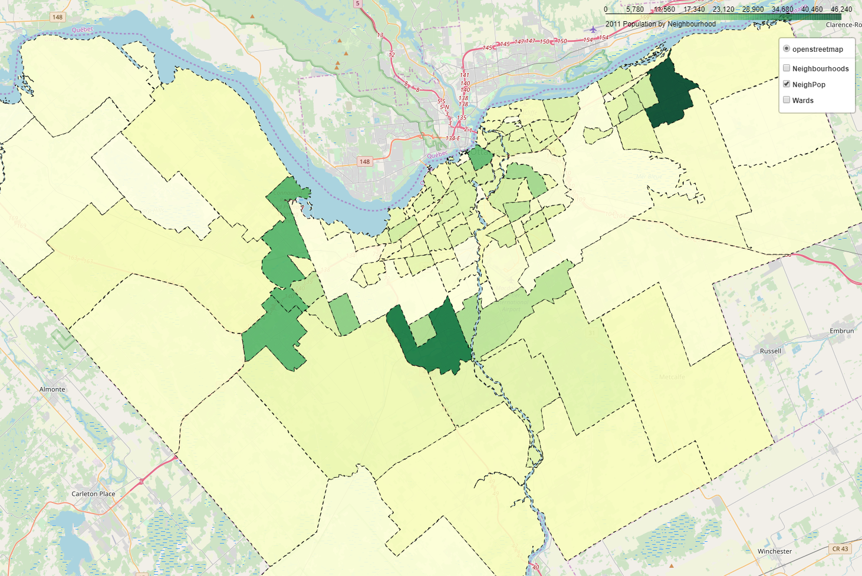
Neighbourhoods and population
1
5
Top 5 neighbourhoods by population density are:
1. Orléans Avalon - Notting Gate - Fallingbrook - Gardenway South
2. Stonebridge - Halfmoon Bay - Heart's Desire
3. Kanata Lakes - Marchwood Lakeside - Morgan's Grant- Kanata North Business Park
4. Stittsville
5. Centretown
3
4
2

Slide 5
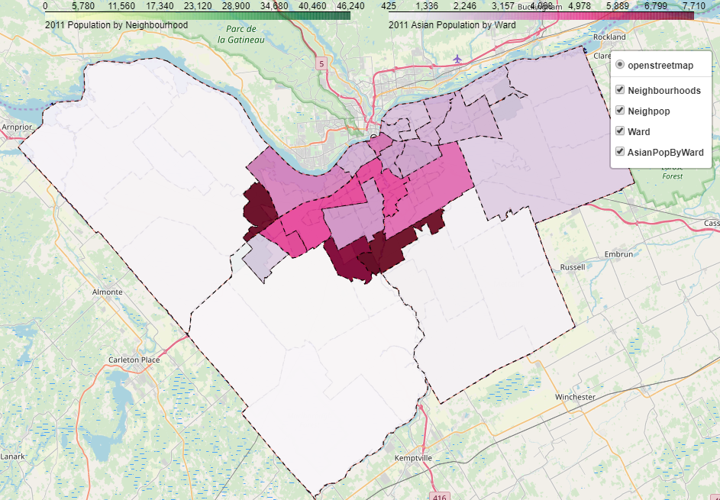
Wards and Asian population
5
Top 5 wards with the most Asian population:
1. Gloucester-South Nepean
2. Kanata North
3. Barrhaven
4. Kanata South
5. College
2
4
1
3

Slide 6
Most desirable neighbourhoods to open an Asian restaurant
A) Stonebridge - Halfmoon Bay - Heart's Desire, and,
B) Kanata Lakes - Marchwood Lakeside - Morgan's Grant- Kanata North Business Park
Because they have the highest population density and Asian ratio.
These will be our focus areas.
Abbreviations:
Stonebridge = Stonebridge - Halfmoon Bay - Heart's Desire
Kanata Lakes = Kanata Lakes - Marchwood Lakeside - Morgan's Grant- Kanata North Business Park
B
A

Slide 7
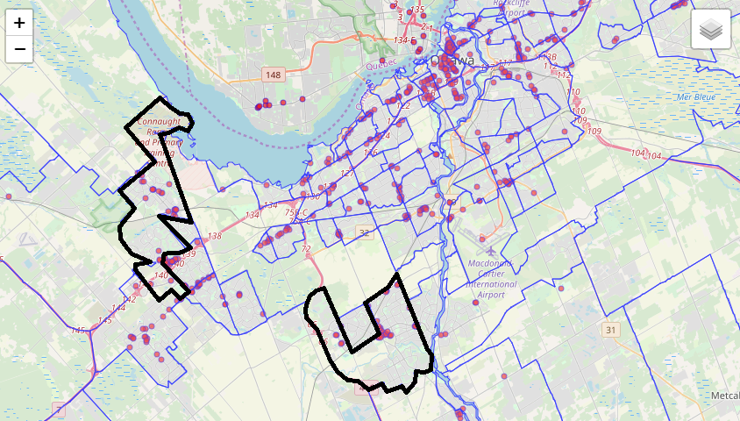
All Ottawa Restaurants
Kanata Lakes
There are more restaurants in and near the Kanata Lakes neighbourhood compared to Stonebridge.
Stonebridge

Slide 8
Existing competitors in each neighbourhood
Kanata Lakes
Stonebridge
2 good rated Vietnamese restaurants
1 good rated Vietnamese restaurant
Competitor | Category | Rate
Lucky Dragon | Chinese Restaurant | na
Phu Yen | Vietnamese Restaurant | 7.5
Kanata Noodle House | Vietnamese Restaurant | 8.5
Competitor | Category | Rate
China Star | Chinese Restaurant | na
1000 Sushi Islands | Sushi Restaurant | 5.7
Barrhaven Vietnamese Restaurant | Vietnamese Restaurant | 7.6

Slide 9
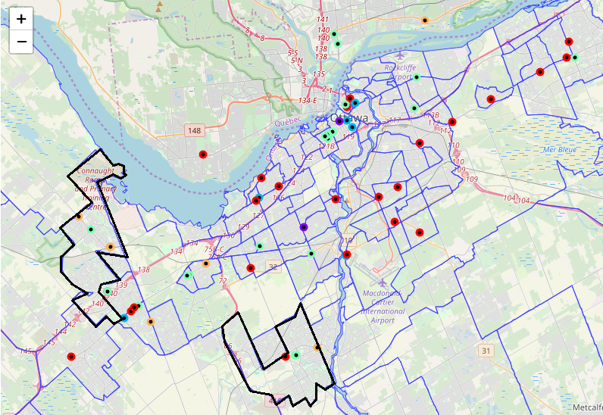
Clustering* for Competitor Insights
Kanata Lakes
2 restaurants possess high ratings, are well liked and have affordable menu items (cluster 1).
Both neighbourhoods have:
restaurants with little to no online presence (website, social media).
The number of likes on Foursquare are relatively low.
Stonebridge
Name | Colour | Rating | Price | Likes | Online Presences
Cluster 1 | Purple | 8+ | 1.5 | High | High
Cluster 2 | Blue | 8+ | 2.5 | Moderate | High
Cluster 3 | Mint | 7+ | 1.8 | Low/Moderate | Low
Cluster 4 | Red | 7+ | 2 | Low | Low
Cluster 5 | Orange | None | 1.5 | Low | None

Slide 10
Conclusion
Ann should open her restaurant in the Stonebridge neighbourhood due to it being a highly populated area with a high Asian ratio and with low Asian restaurant competition.
Ann should create a strong online presence by hosting a restaurant website and establishing a social media following.
Menu prices don’t seem to be correlated with ratings.
Suggested restaurant categories: Korean or Japanese
Low competition
Generally higher rated than others

